Slide 1
Weather Updates App/Website
NAME: JAJAM THARUNI
ORGANIZATION: MICRO IT
TOPIC: WEATHER UPDATES APP/WEBSITE

Slide 2
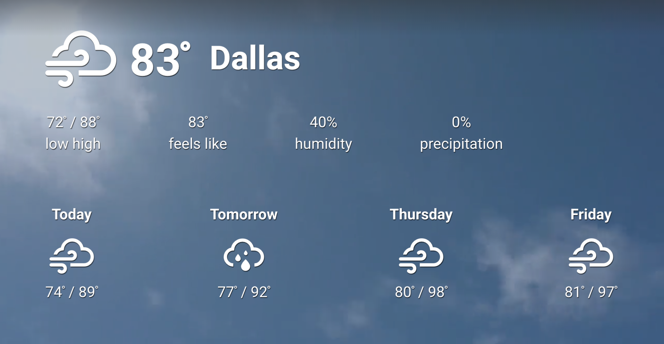
Introduction to the Weather Updates App/Website
The Weather Updates App/Website aims to provide real-time weather information to users.
It will feature a user-friendly interface designed for both mobile and desktop platforms.
The app/website will cater to a diverse audience, including casual users and weather enthusiasts.
1
Notes:
Image source: https://docs.appspace.com

Slide 3
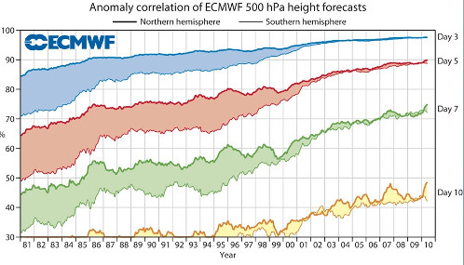
Key Features
Users will receive accurate weather forecasts, including temperature, humidity, and precipitation.
The app will offer severe weather alerts to keep users informed of dangerous conditions.
Interactive maps will enhance user experience by visualizing weather patterns and trends.
2
Notes:
Image source: https://www.longrangeweatherforecast.co.uk

Slide 4

Target Audience
The primary audience includes individuals seeking daily weather updates for planning purposes.
Outdoor enthusiasts, such as hikers and cyclists, will benefit from localized forecasts.
Businesses, particularly those in agriculture and event planning, will find the app's insights invaluable.
3
Notes:
Image source: https://cdn.slidesharecdn.com

Slide 5

Technology Stack
The app will be built using React Native for mobile development, ensuring cross-platform compatibility.
A robust backend will be powered by Node.js and Express, providing efficient data processing.
The weather data will be sourced from reliable APIs like OpenWeatherMap and WeatherAPI.
4
Notes:
Image source: https://www.silvertouch.ca

Slide 6

User Experience Design
The design will focus on simplicity and accessibility for users of all technical backgrounds.
Color-coded weather indicators will help users quickly grasp current conditions at a glance.
User feedback will be gathered through surveys to continually improve the interface and features.
5
Notes:
Image source: https://squibble.design

Slide 7
Monetization Strategy
The app will offer a free version supported by ads to attract a wide user base.
A premium subscription model will provide ad-free usage and access to advanced features.
Partnerships with local businesses for advertising opportunities will enhance revenue streams.
6
Notes:
Image source: https://www.slidemake.com

Slide 8

Marketing Plan
Social media campaigns will target potential users by showcasing unique app features.
Collaborations with influencers in the travel and outdoor niches will boost visibility.
Search engine optimization (SEO) strategies will be employed to improve app discoverability online.
7
Notes:
Image source: https://thumbs.dreamstime.com

Slide 9
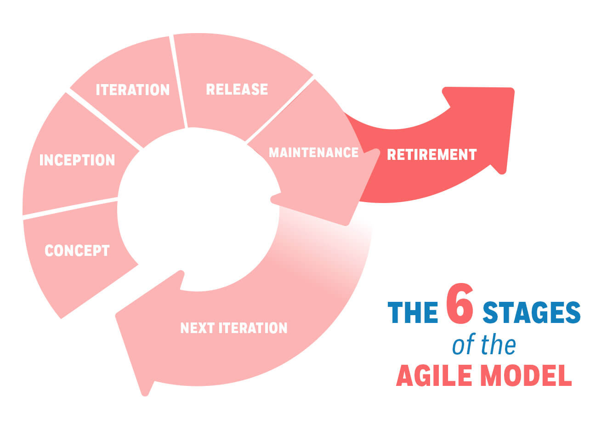
Development Timeline
The project will follow an Agile development methodology to ensure flexibility and responsiveness.
Initial phases will focus on design and backend development, projected to last six months.
User testing and bug fixing will take place in the final phase, scheduled for three months.
8
Notes:
Image source: https://managementhelp.org

Slide 10
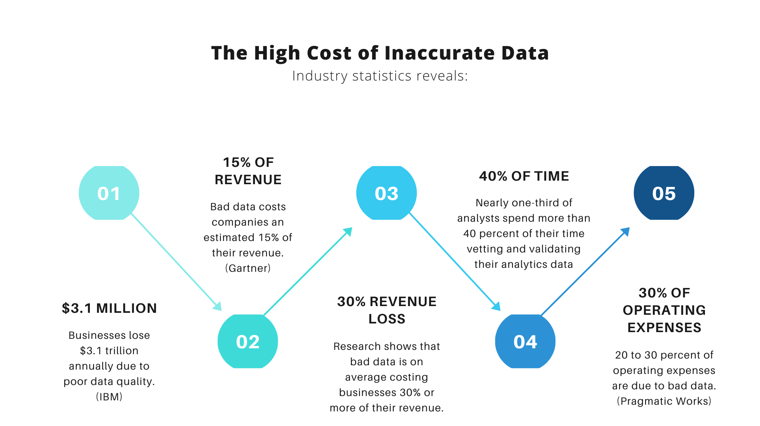
Challenges and Solutions
Data accuracy and reliability can be a challenge; partnerships with multiple weather data providers will mitigate this.
User retention is critical; incorporating gamification elements can enhance engagement.
Ensuring cross-platform performance may lead to technical difficulties, which will be addressed through rigorous testing.
9
Notes:
Image source: https://dataladder.com

Slide 11
Conclusion and Next Steps
The Weather Updates App/Website project is poised to meet a growing demand for reliable weather information.
Next steps include finalizing the project plan and assembling a dedicated development team.
Stakeholders will be engaged in regular updates to ensure alignment with user needs and expectations.
10
Notes:
Image source: https://www.slidemake.com

